Slide 1
Chapter 5
Large and Fast: Exploiting Memory Hierarchy

Slide 2
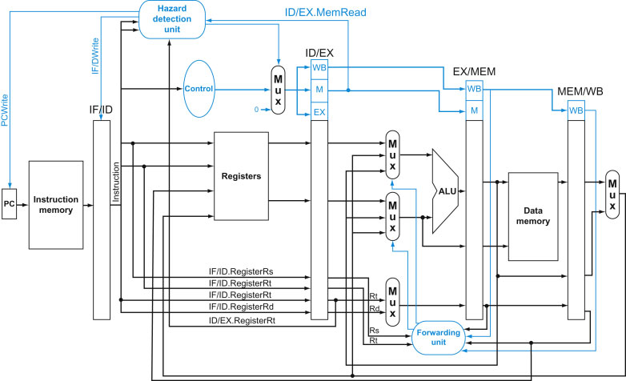
FIGURE 4.60 Pipelined control overview, showing the two multiplexors for forwarding, the hazard detection unit, and the forwarding unit. Although the ID and EX stages have been simplified—the sign-extended immediate and branch logic are missing—this drawing gives the essence of the forwarding hardware requirements.
2
Copyright © 2014 Elsevier Inc. All rights reserved.

Slide 3
Principle of Locality
§5.1 Introduction
Fact of programs:
During any period of time, a program accesses a relatively small proportion of its address space.
That is, related instructions/data tend to cluster together, instead of “jumping around”
This is true for both instruction space and data space
We wanted to take advantage of this fact, to make the computer run faster

Slide 4
Principle of Locality
§5.1 Introduction
program
(instructions)
data (integers, arrays)

Slide 5
Principle of Locality
§5.1 Introduction
Temporal locality
Items (instructions or data) accessed recently are likely to be accessed again soon
Examples:
instructions in a loop
recursive calls

Slide 6
Principle of Locality
§5.1 Introduction
Spatial locality
Items near those accessed recently are likely to be accessed soon
Examples:
sequential instruction access
array data

Slide 7
Taking Advantage of Locality
The computer’s memory system is organized in hierarchy
Store everything on disk
Hard drive (largest, cheap, permanent storage)
Copy recently accessed (and nearby) items from disk to smaller DRAM memory
Main memory (smaller, more expensive)
Copy more recently accessed (and nearby) items from DRAM to smaller SRAM memory
Cache memory attached to CPU (smallest, most expensive)

Slide 8
Taking Advantage of Locality
The computer’s memory system is organized in hierarchy
Everything is eventually stored on disk
Hard drive (largest, cheap, permanent storage)
Copy recently accessed (and nearby) items from disk to smaller DRAM memory
Main memory (smaller, more expensive)
Copy more recently accessed (and nearby) items from DRAM to smaller SRAM memory
Cache memory attached to CPU (smallest, most expensive)

Slide 9
Taking Advantage of Locality
The computer’s memory system is organized in hierarchy
Everything is eventually stored on disk
Hard drive (largest, cheap, permanent storage)
Copy recently accessed (and nearby) items from disk to smaller DRAM memory
Main memory (smaller, more expensive)

Slide 10
Taking Advantage of Locality
The computer’s memory system is organized in hierarchy
Everything is eventually stored on disk
Hard drive (largest, cheap, permanent storage)
Copy recently accessed (and nearby) items from disk to smaller DRAM memory
Main memory (smaller, more expensive, fast)
Copy more recently accessed (and nearby) items from DRAM to smaller SRAM memory
Cache memory attached to CPU (smallest, most expensive, fastest)

Slide 11
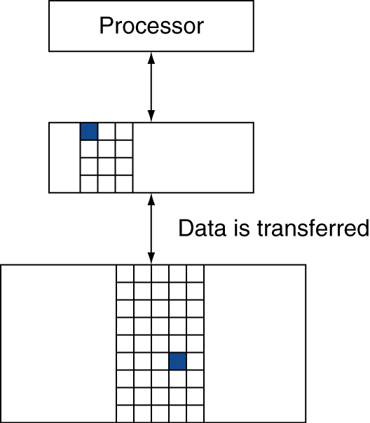
Memory Hierarchy Levels
Block (aka line): unit of copying
May be multiple words
If accessed data is present in upper level
Called Hit: access satisfied by upper level
Hit ratio: hits/accesses
If accessed data is absent in upper
Called Miss: block copied from lower level
Time taken: miss penalty
Miss ratio: misses/accesses = 1 – hit ratio
Then accessed data supplied from upper level
cache
Hit
Miss
RAM

Slide 12
Memory Technology
Static RAM (SRAM, used by cache)
0.5ns – 2.5ns, $2000 – $5000 per GB
Dynamic RAM (DRAM) ≈ 100 times
50ns – 70ns, $20 – $75 per GB
Magnetic disk ≈ 100 times
5ms – 20ms, $0.20 – $2 per GB
Ideal memory:
Access time of cache
Capacity and cost/GB of disk
§5.2 Memory Technologies

Slide 13
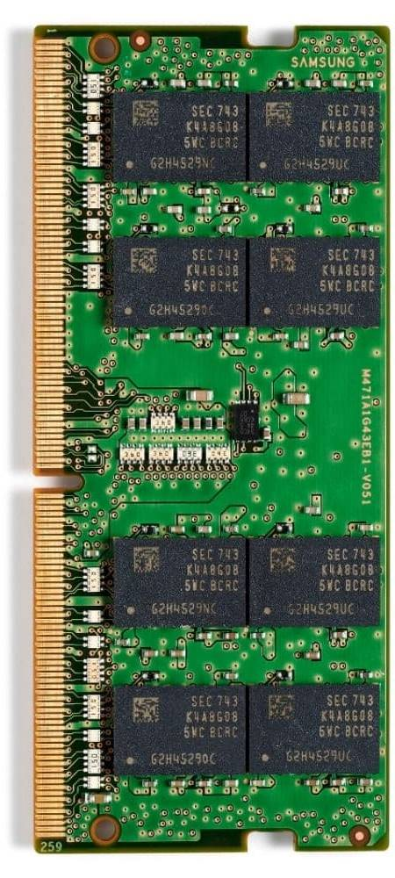
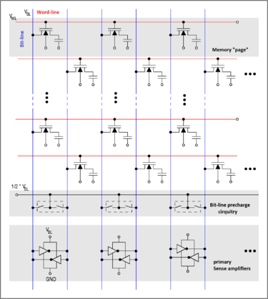
DRAM
Data (bits) are stored as a charge in a capacitor
Single transistor used to access the charge
Must periodically be refreshed (volatile)
Refreshed by reading contents and writing back
Performed on a DRAM “row”

Slide 14
Raising DRAM Performance
Row buffer
Allows several words to be read and refreshed in parallel (not just one word at a time)
Synchronous DRAM
Consecutive accesses in bursts without needing to send each address
Improves bandwidth
DRAM banking
Simultaneous access to multiple DRAM “banks”
Improves bandwidth

Slide 15
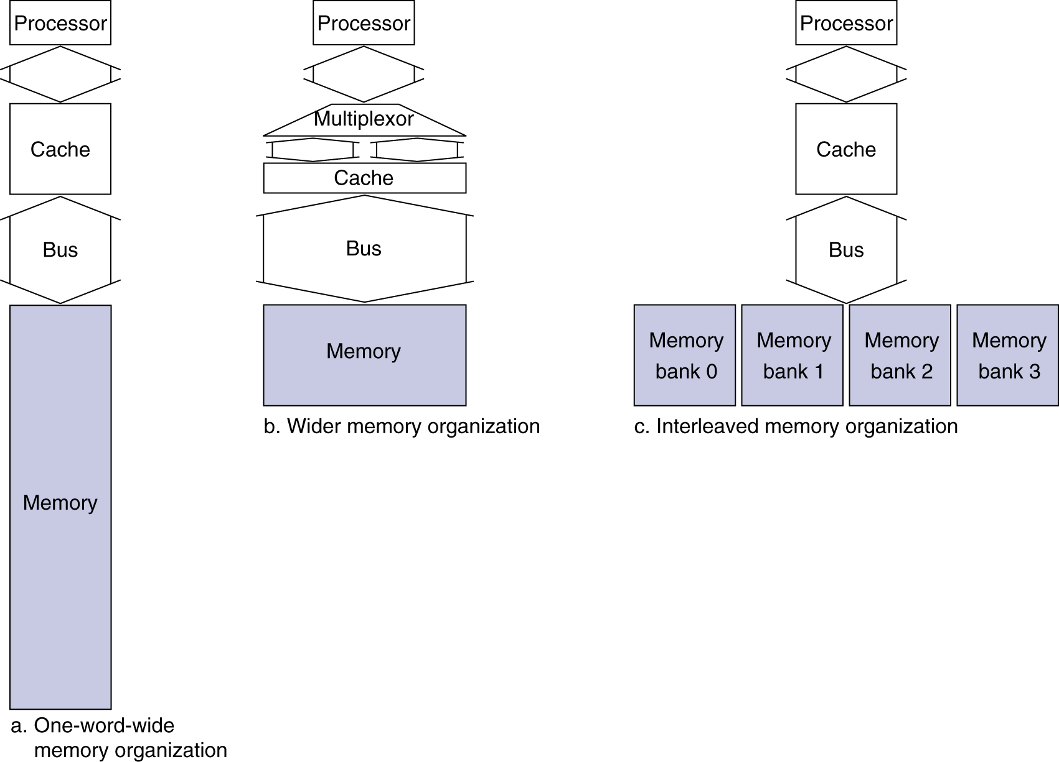
Increasing Memory Bandwidth
Memory banks
Wider bus
Higher bandwidth
b. 4-word wide mem (15 cycles to connect to mem)
Miss penalty = 1 + 15 + 1 = 17 bus cycles
missed access (1), connect mem (15), load cache (1)
Bandwidth = 16 bytes / 17 cycles = 0.94 bytes/cycle
c. 4-bank interleaved memory
Miss penalty = 1 + 15 + 4×1 = 20 bus cycles
Bandwidth = 16 bytes / 20 cycles = 0.8 bytes/cycle

Slide 16
Increasing Memory Bandwidth
Memory banks
Wider bus
Higher bandwidth
b. 4-word wide mem (15 cycles to connect to mem)
Miss penalty = 1 + 15 + 1 = 17 bus cycles
missed access (1), connect mem (15), load cache (1)
Bandwidth = 16 bytes / 17 cycles = 0.94 bytes/cycle
c. 4-bank interleaved memory
Miss penalty = 1 + 15 + 4×1 = 20 bus cycles
Bandwidth = 16 bytes / 20 cycles = 0.8 bytes/cycle

Slide 17
Increasing Memory Bandwidth
Memory banks
Wider bus
Higher bandwidth
b. 4-word wide mem (15 cycles to connect to mem)
Miss penalty = 1 + 15 + 1 = 17 bus cycles
missed access (1), connect mem (15), load cache (1)
Bandwidth = 16 bytes / 17 cycles = 0.94 bytes/cycle
c. 4-bank interleaved memory
Miss penalty = 1 + 15 + 4×1 = 20 bus cycles
Bandwidth = 16 bytes / 20 cycles = 0.8 bytes/cycle

Slide 18
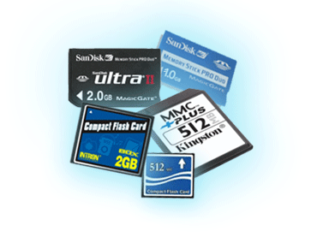
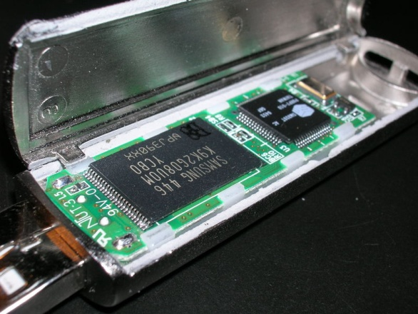
Flash Storage (Solid State)
§6.4 Flash Storage
Nonvolatile semiconductor storage
Faster than disk, but still slower than DRAM
Smaller, lower power, more robust
But more $/GB (between disk and DRAM)
SSD replacing magnetic drives

Slide 19
Flash Types
NOR flash: bit cell like a NOR gate
Random read/write access
Used for instruction memory in embedded systems
NAND flash: bit cell like a NAND gate
Denser (bits/area), but block-at-a-time access
Cheaper per GB
Used for USB keys, media storage, …
Flash bits wears out after 1000’s of accesses
Not suitable for direct RAM or disk replacement
Wear leveling: remap data to less used blocks

Slide 20

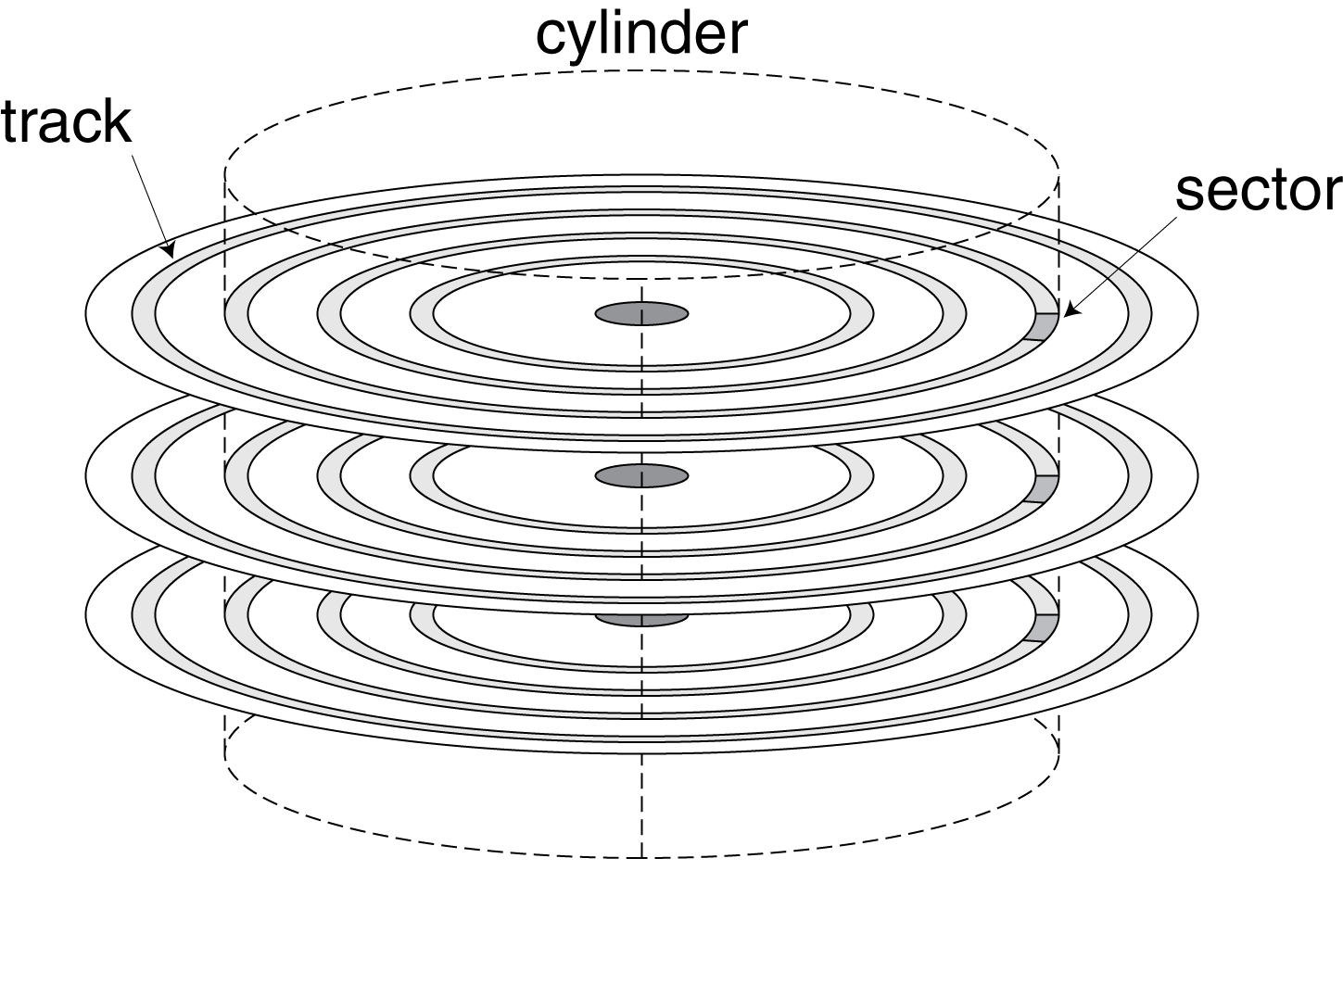
Disk Storage (Hard Disk)
§6.3 Disk Storage
Nonvolatile, rotating magnetic storage

Slide 21
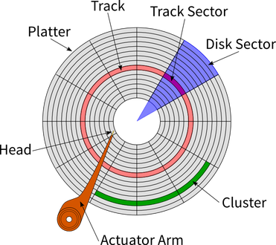
Disk Storage (Hard Disk)
§6.3 Disk Storage
Nonvolatile, rotating magnetic storage

Slide 22
Disk Sectors and Access
Each sector contains:
Sector ID
Data (512 bytes (0.5KB) - 4096 bytes (4KB))
Error correcting code (ECC)
Used to hide defects and recording errors
Synchronization fields and gaps
Access to a sector involves
Queuing delay if other accesses are pending
Seek: move the heads (mechanical operation, slow)
Rotational latency (mechanical operation, slow)
Data transfer
Controller overhead

Slide 23
Disk Sectors and Access
Each sector contains:
Sector ID
Data (512 bytes (0.5KB) - 4096 bytes (4KB))
Error correcting code (ECC)
Used to hide defects and recording errors
Synchronization fields and gaps
Access to a sector involves:
Queuing delay if previous accesses are on-going
Seek: turn the heads (mechanical operation, slow)
Disk rotational latency (mechanical operation, slow)
Data transfer
Controller overhead

Slide 24
Disk Access Example
Given
512B sector, 15,000rpm, 4ms average seek time, 100MB/s transfer rate, 0.2ms controller overhead, idle disk
Average read time (to read 1 sector (512B))
4ms seek time (time of head turning) + ½ / (15,000/60) = 2ms avg rotational latency + 512B / 100MB/s ≈ 0.005ms transfer time + 0.2ms controller delay = 6.2ms (majority mechanical time)
If actual average seek time is 1ms
Average read time = 3.2ms

Slide 25
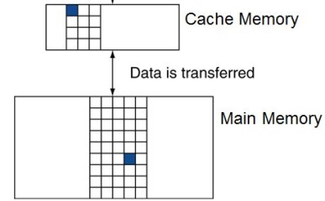
FIGURE 4.60 Pipelined control overview, showing the two multiplexors for forwarding, the hazard detection unit, and the forwarding unit. Although the ID and EX stages have been simplified—the sign-extended immediate and branch logic are missing—this drawing gives the essence of the forwarding hardware requirements.
25
Copyright © 2014 Elsevier Inc. All rights reserved.

Slide 26
Memory Hierarchy Levels
Cache Memory
Main Memory -- RAM

Slide 27
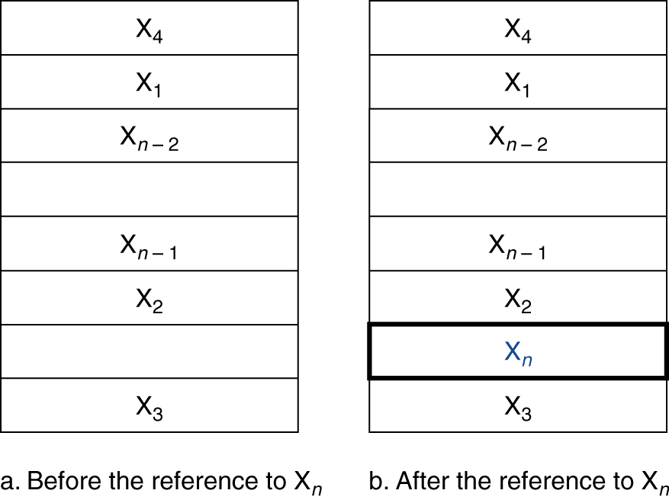
Cache
Cache memory
It is the level of the memory hierarchy closest to the CPU, the fastest, and the most costly
Given accesses X₁, …, X_{n–1}, X_{n} (mem addr)
§5.3 The Basics of Caches
Cache
Cache
How do we know if the data is present?
Where do we look?
Is x_{n} in Cache?

Slide 28
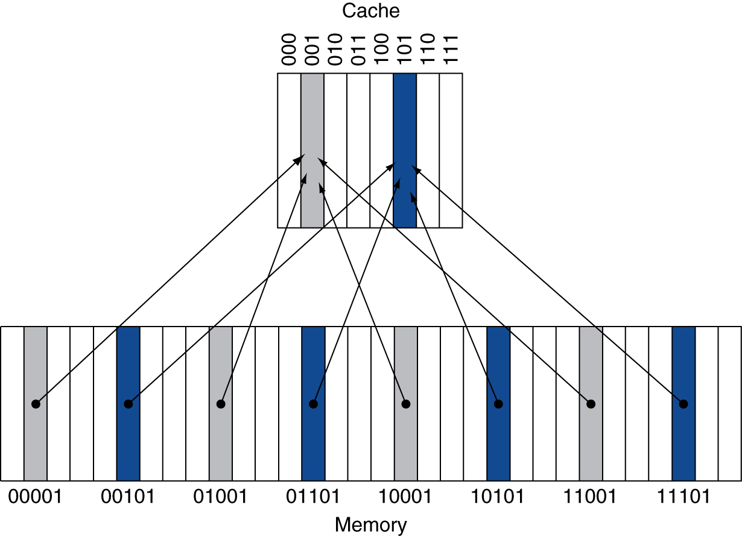
Direct Mapped Cache
Location determined by address
Direct mapped: only one choice
Cache address = (Block address) % (#Blocks in cache)
In example below, 32-addr mem, 8-addr cache, 1-word block
address in memory
If #Blocks is a power of 2, just use low-order address bits for Cache address
Cache
Mem

Slide 29
Tags and Valid Bits
Mem addresses
00001, 01001, 10001, 11001
will all be mapped to cache address 001
How do we know which particular word is currently in a cache location?
Store the whole address along with the data
Actually, only need to store the high-order bits (called “tag”)
What if there is no data in a cache address?
Valid bit: 1 = present, 0 = not present; Initially 0

Slide 30
Cache Example
8-blocks, 1 word/block, direct mapped
Address sequence: 22, 26, 22, 26, 16, 13, 16, 18
Initial cache state
Index | V | Tag | Data
000 | 0
001 | 0
010 | 0
011 | 0
100 | 0
101 | 0
110 | 0
111 | 0

Slide 31
Cache Example
Word addr | Binary addr | Hit/miss | Cache block
22 | 10 110 | Miss | 110
Index | V | Tag | Data
000 | 0
001 | 0
010 | 0
011 | 0
100 | 0
101 | 0
110 | 1 | 10 | Mem[10110]
111 | 0

Slide 32
Cache Example
Word addr | Binary addr | Hit/miss | Cache block
26 | 11 010 | Miss | 010
Index | V | Tag | Data
000 | 0
001 | 0
010 | 1 | 11 | Mem[11010]
011 | 0
100 | 0
101 | 0
110 | 1 | 10 | Mem[10110]
111 | 0

Slide 33
Cache Example
Word addr | Binary addr | Hit/miss | Cache block
22 | 10 110 | Hit | 110
26 | 11 010 | Hit | 010
Index | V | Tag | Data
000 | 0
001 | 0
010 | 1 | 11 | Mem[11010]
011 | 0
100 | 0
101 | 0
110 | 1 | 10 | Mem[10110]
111 | 0

Slide 34
Cache Example
Word addr | Binary addr | Hit/miss | Cache block
16 | 10 000 | Miss | 000
3 | 00 011 | Miss | 011
16 | 10 000 | Hit | 000
Index | V | Tag | Data
000 | 1 | 10 | Mem[10000]
001 | 0
010 | 1 | 11 | Mem[11010]
011 | 1 | 00 | Mem[00011]
100 | 0
101 | 0
110 | 1 | 10 | Mem[10110]
111 | 0

Slide 35
Cache Example
Word addr | Binary addr | Hit/miss | Cache block
18 | 10 010 | Miss | 010
Index | V | Tag | Data
000 | 1 | 10 | Mem[10000]
001 | 0
010 | 1 | 10 | Mem[10010]
011 | 1 | 00 | Mem[00011]
100 | 0
101 | 0
110 | 1 | 10 | Mem[10110]
111 | 0

Slide 36
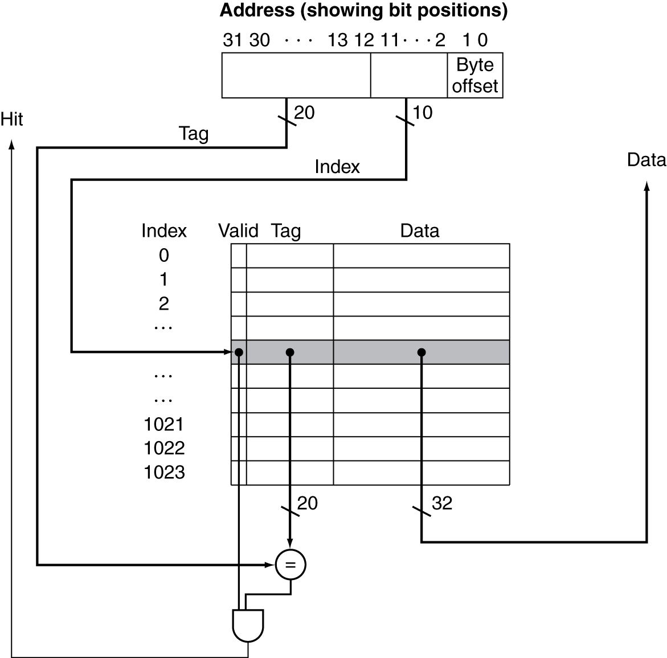
Address Subdivision

Slide 37
Address Subdivision

Slide 38
Larger Block Size - Example
64-block cache, 16 bytes/block (4-word)
To what block number does byte address 1200 map?
Block address = ⎣1200/16⎦ = 75
Block number = 75 % 64 = 11
31
10
9
4
3
0
Tag
Index
Offset
22 bits
6 bits
4 bits
Block number

Slide 39
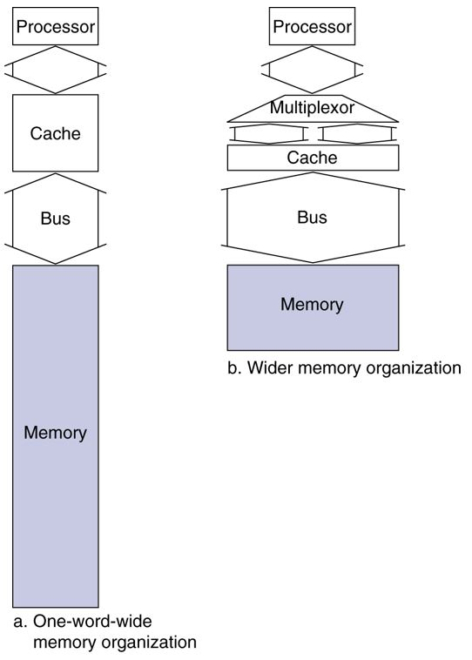
Single-word vs. Multi-word Cache
single-word cache block
multi-word cache block

Slide 40
Single-word vs. Multi-word Cache
single-word cache block

Slide 41
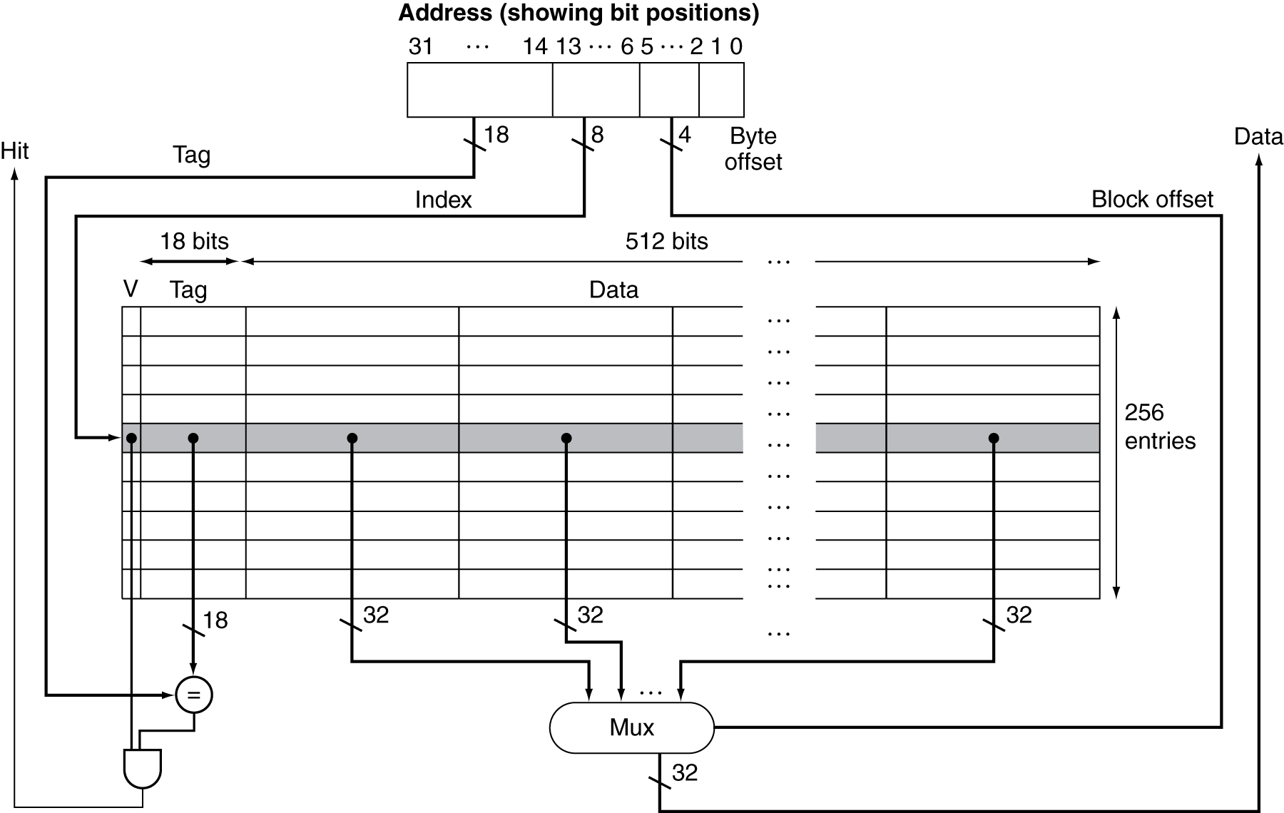
Single-word vs. Multi-word Cache
16-word cache block
(16 words)
(256
blocks)

Slide 42
Block Size Considerations
Larger blocks should reduce miss rate
Due to spatial locality
But it’s not always “the larger, the better”

Slide 43
Block Size Considerations
In a fixed-sized cache
Larger blocks ⇒ fewer blocks
More competition ⇒ increased “block miss rate”
Larger miss penalty
When replacing a block due to miss, some soon-needed addrs may be swapped out
Can cancel benefit of reduced miss rate
Need to determine an appropriate block size – tradeoff

Slide 44
Block Size Considerations

Slide 45
Memory Hierarchy Levels
Cache Memory
Main Memory -- RAM

Slide 46
Cache Hits
Ex. lw $1, 0($2)
On cache hit, CPU proceeds normally
lw $1, 0($2)
cache
Hit
RAM

Slide 47
Cache Misses
On cache miss
Stall the CPU pipeline
Fetch block from mem (lower level of hierarchy)
After fetch:
For instruction cache miss
Restart instruction fetch
For data cache miss
Complete data access
lw $1, 0($2)
cache
Hit
Miss

Slide 48
Write-Through (Issues on Hit)
On data-write hit, could just update the block in cache
But then cache and memory would be inconsistent
5
5

Slide 49
Write-Through (on Hit)
On data-write hit, could just update the block in cache
But then cache and memory would be inconsistent
write
6
5

Slide 50
Write-Through (on Hit)
Write-through: also update memory
write
6
6

Slide 51
Write-Through (on Hit)
But that makes write operation take longer
e.g., if base CPI = 1, 10% of instructions are stores (sw)
Assume write to memory takes 100 cycles
Effective CPI = 1 + 0.1×100 = 11
Due to write-through, “sw” instruction is a potentially more expensive instruction than “lw”

Slide 52
Write-Through
Try to make it quicker: Use a “write buffer”
Holds data waiting to be written to memory
CPU continues immediately
Only stalls on write if write buffer is already full
Put it aside first (buffering), and write later in a batch
6
6
write
buffer
5

Slide 53
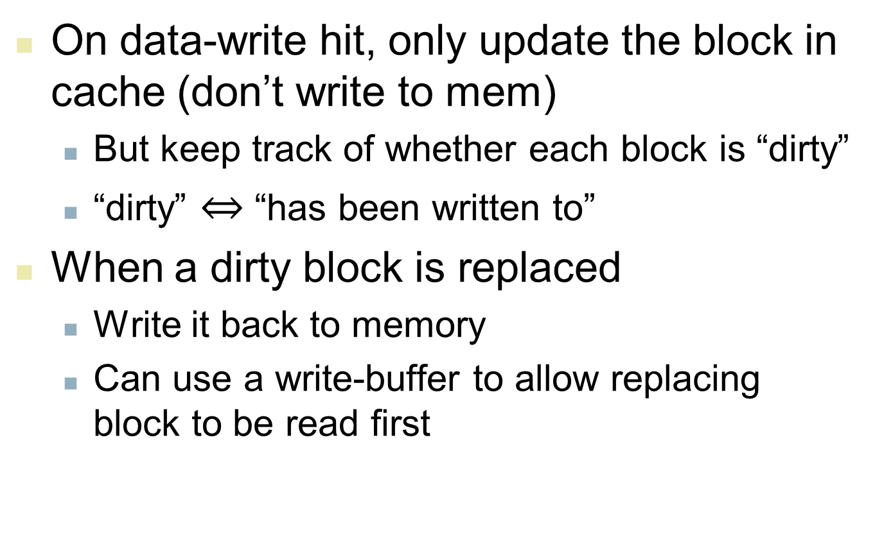
Alternative: Write-Back
On data-write hit, only update the block in cache (don’t write to mem)
But keep track of whether each block is “dirty”
“dirty” $⇔$ “has been written to”
When a dirty block is replaced
Write it back to memory
Can use a write-buffer to allow replacing block to be read first

Slide 54
Write Allocation
What should happen on a write miss?
For write-through, two alternatives:
1. Allocate on miss: fetch the block, then write
2. Write-around: don’t fetch the block
Since programs often write a whole block before reading it (e.g., initialization)
Don’t fetch the block until the first read-miss
For write-back
Need to read into write-buffer in cache
So need to fetch the block, and flag dirty

Slide 55
Real example: Intrinsity FastMATH
Embedded MIPS processor
12-stage pipeline (we discussed 5-stage procsr)
Instruction and data access on each cycle
Split cache: separate I-cache and D-cache
I: Instruction; D: Data
Each 16KB Cache: 256 blocks × 16 words/block
D-cache: write-through or write-back
SPEC2000 miss rates (real statistics)
I-cache: 0.4% 99.6% of instructions fetched from cache
D-cache: 11.4% 88.6% of data lw/sw in cache
Weighted average miss rate: 3.2%

Slide 56
Example: Intrinsity FastMATH

Slide 57
Main Memory Supporting Caches
Use DRAMs for main memory
Fixed width (e.g., 1 word)
Connected by fixed-width clocked bus
Bus clock is typically slower than CPU clock
Example cache block read (mem → cache)
1 bus cycle for address transfer
15 bus cycles per DRAM access
1 bus cycle per data transfer

Slide 58
Main Memory Supporting Caches
For 4-word block cache, 1-word-wide DRAM
Miss penalty = 1 + 4×15 + 4×1 = 65 bus cycles
Bandwidth = 16 bytes / 65 cycles = 0.25 bytes/cycle
Memory banks
Wider bus
Higher bandwidth
b. 4-word wide mem (15 cycles to connect to mem)
Miss penalty = 1 + 15 + 1 = 17 bus cycles
missed access (1), connect mem (15), load cache (1)
Bandwidth = 16 bytes / 17 cycles = 0.94 bytes/cycle
c. 4-bank interleaved memory
Miss penalty = 1 + 15 + 4×1 = 20 bus cycles
Bandwidth = 16 bytes / 20 cycles = 0.8 bytes/cycle
Memory

Slide 59
Cache Performance Example
Given
I-cache miss rate = 2% (instruction fetch)
D-cache miss rate = 4% (data lw/sw)
Miss penalty = 100 cycles
Base CPI (ideal cache) = 2
Load & stores are 36% of instructions
Miss penalty per instruction
I-cache: 100% × 2% × 100 = 2
D-cache: 36% × 4% × 100 = 1.44
Actual average CPI = 2 + 2 + 1.44 = 5.44
5.44/2 =2.72 times slower than ideal CPU
1 cycle address transfer
1 data transfer
access cache
100% of times
36% of times need
to access again

Slide 60
Average Access Time
Hit time is also important for performance
Average memory access time (AMAT)
AMAT = Hit time + Miss rate × Miss penalty
Example
CPU with 1ns clock, hit time = 1 cycle, miss penalty = 20 cycles, I-cache miss rate = 5%
AMAT = 1 + 5%×20 = 2ns
2 cycles per instruction
(cache cycle, not memory cycle)

Slide 61
FIGURE 4.60 Pipelined control overview, showing the two multiplexors for forwarding, the hazard detection unit, and the forwarding unit. Although the ID and EX stages have been simplified—the sign-extended immediate and branch logic are missing—this drawing gives the essence of the forwarding hardware requirements.
61
Copyright © 2014 Elsevier Inc. All rights reserved.

Slide 62
Direct Mapped Cache
Location determined by address
Direct mapped: only one choice
Cache address = (Block address) % (#Blocks in cache)
In example below, 32-addr mem, 8-addr cache, 1-word block
address in memory
If #Blocks is a power of 2, just use low-order address bits for Cache address
Cache
Mem

Slide 63
Associative Caches
Purpose: To increase hit-rate
Fully associative
Non-fixed mapping
Allow a given block to go in any cache entry
Requires all entries to be searched at once
Comparator (tags) at every entry (expensive)
Not fully associative: n-way set associative
Cache is divided into several sets
Allow a given block to go in any cache entry in a certain set

Slide 64
Associative Caches

Slide 65
Associative Caches
n-way set associative
Each set contains n entries
Block number (memory address) determines which set it can go
Set # = (Block number) % (# of sets in cache)
Search all entries in a given set at once
n tag comparators (less expensive)

Slide 66
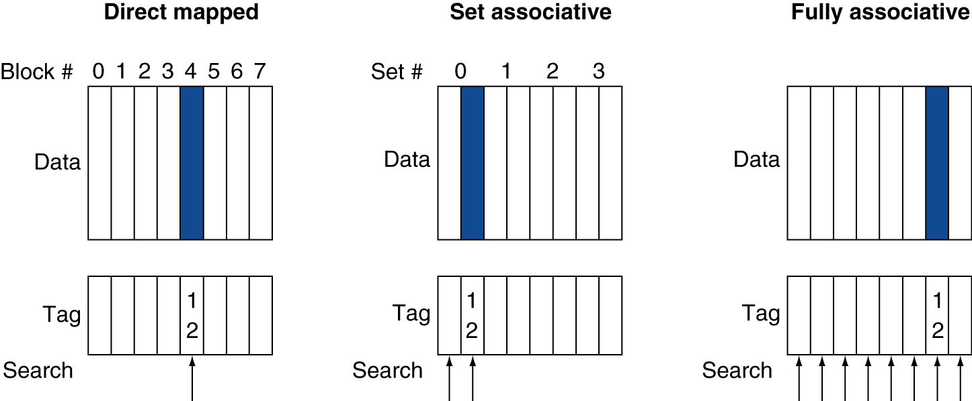
Associative Cache Example
Set # 0
address 12 = 1100
address 12 = 1100
address 12 = 1100
Set # = 12 % 4 = 0
Set # = 12 % 1 = 0

Slide 67
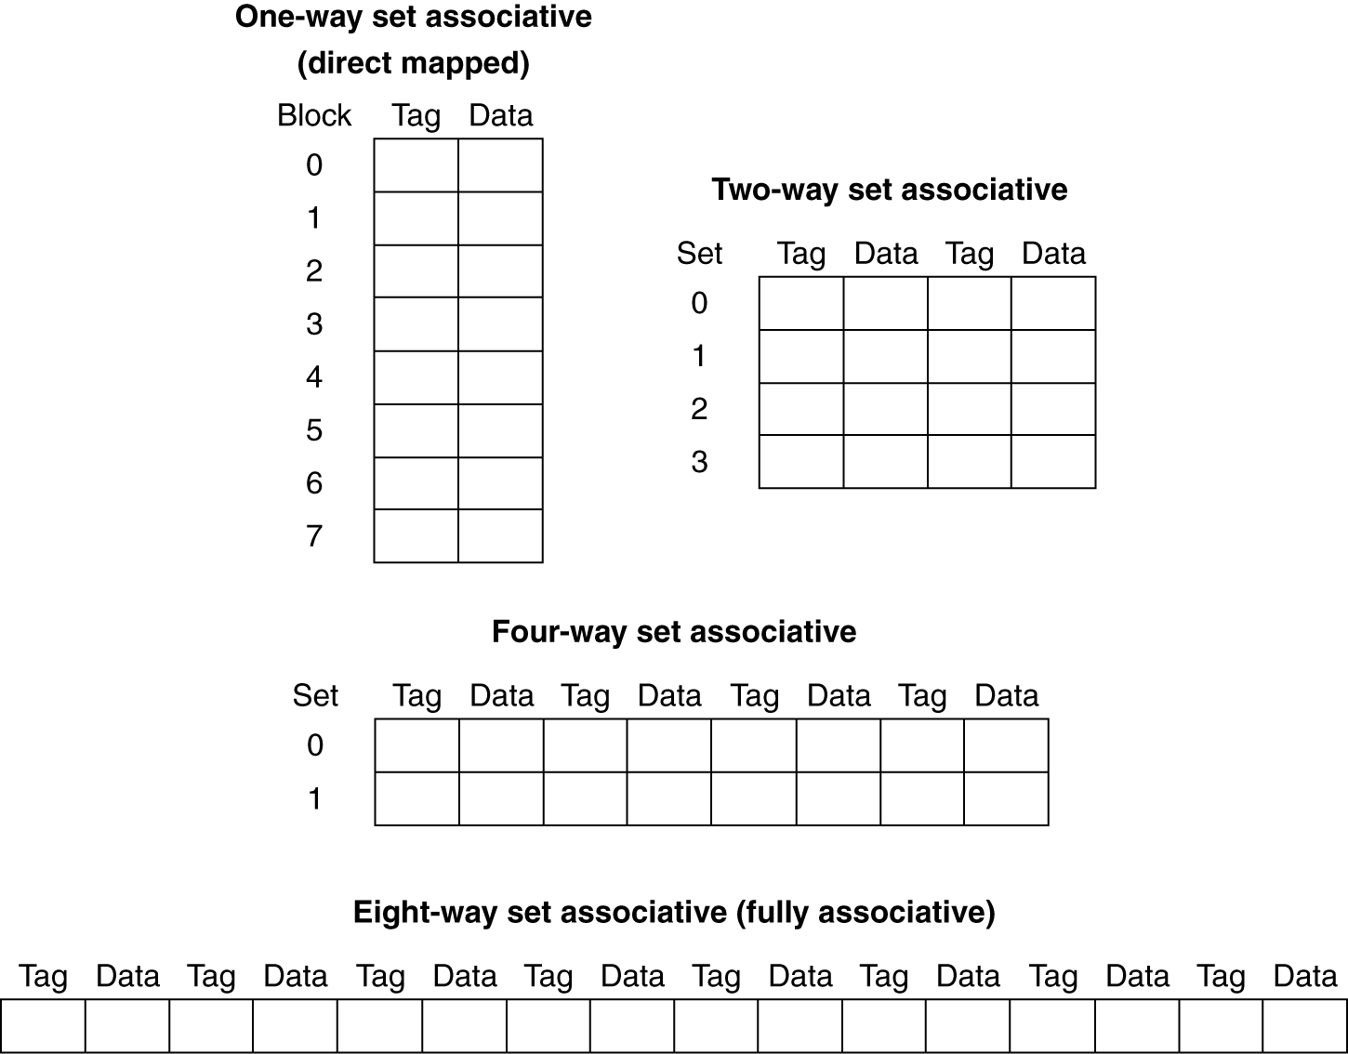
Spectrum of Associativity
For a cache with 8 entries
(4 sets)
address 14 = 1110
address 14 = 1110
(2 sets)
address 14 = 1110
(1 set)
Set
0
address 14 = 1110

Slide 68
Associative Cache Example
Compare 4-block caches (00,01,10,11)
Direct mapped (4 sets); 2-way associative (2 sets); fully associative (4-way, 1 set)
Consider block access sequence:
0, 8, 0, 6, 8

Slide 69
Associative Cache Example
Block access sequence: 0, 8, 0, 6, 8
i.e. 0000, 1000, 0000, 0110, 1000 (mem addr)
Direct mapped (4 sets)
Block address | Cache index | Hit/miss | Cache content after access
 |  |  | 0:address ending 00 | 1:address ending 01 | 2:address ending 10 | 3:address ending 11
0 | 00 | miss | Mem[0]
8 | 00 | miss | Mem[8]
0 | 00 | miss | Mem[0]
6 | 10 | miss | Mem[0] |  | Mem[6]
8 | 00 | miss | Mem[8] |  | Mem[6]
time

Slide 70
Associative Cache Example
2-way set associative (2 sets)
0000, 1000, 0000, 0110, 1000
Block address | Cache index | Hit/miss | Cache content after access
 |  |  | set #0: Address ending with 0 |  | set #1: Address ending with 1
0 | 0 | miss | Mem[0]
8 | 0 | miss | Mem[0] | Mem[8]
0 | 0 | hit | Mem[0] | Mem[8]
6 | 0 | miss | Mem[0] | Mem[6]
8 | 0 | miss | Mem[8] | Mem[6]
Fully associative (1 set)
Block address |  | Hit/miss | Cache content after access Any address, one set of 4-words
0 |  | miss | Mem[0]
8 |  | miss | Mem[0] | Mem[8]
0 |  | hit | Mem[0] | Mem[8]
6 |  | miss | Mem[0] | Mem[8] | Mem[6]
8 |  | hit | Mem[0] | Mem[8] | Mem[6]

Slide 71
How Much Associativity
Increased associativity decreases miss rate
But with diminishing gains
Simulation of a system with 64KB Data-cache, 16-word blocks, SPEC2000
1-way: 10.3% (direct map)
2-way: 8.6%
4-way: 8.3%
8-way: 8.1%

Slide 72
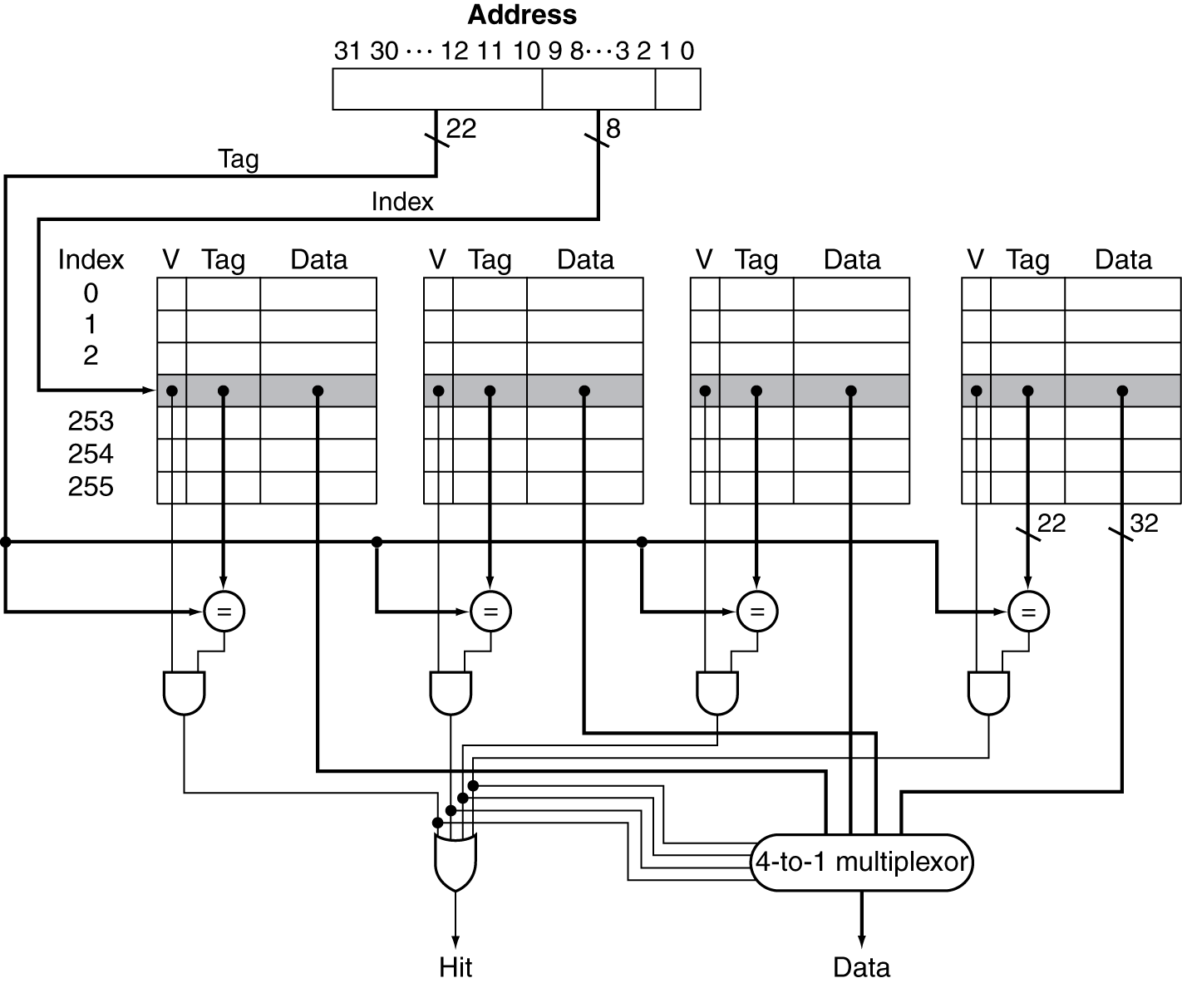
Set Associative Cache Organization
4-way set associative
256 sets
4-word in each set
Mem[Tag(22bits) + 11111100]
Set # 11111100 (=252)

Slide 73
Issue: Replacement Policy
2-way set associative
When Mem[0110] is loaded, replace Mem[8]
Block address | Cache index (set #) | Hit/miss | Cache content after access
 |  |  | Address ending with 0 (set #0) |  | Address ending with 1 (set #1)
0 | 0 | miss | Mem[0]
8 | 0 | miss | Mem[0] | Mem[8]
0 | 0 | hit | Mem[0] | Mem[8]
6 | 0 | miss | Mem[0] | Mem[6]
8 | 0 | miss | Mem[8] | Mem[6]

Slide 74
Issue: Replacement Policy
2-way set associative
When Mem[0110] is loaded, replace Mem[0]
Issue: When Mem[0110] is loaded into cache, which word is to be replaced?
Block address | Cache index (set #) | Hit/miss | Cache content after access
 |  |  | Address ending with 0 (set #0) |  | Address ending with 1 (set #1)
0 | 0 | miss | Mem[0]
8 | 0 | miss | Mem[0] | Mem[8]
0 | 0 | hit | Mem[0] | Mem[8]
6 | 0 | miss | Mem[6] | Mem[8]
8 | 0 | hit | Mem[6] | Mem[8]

Slide 75
Issue: Replacement Policy
Direct mapped: no choice
Set associative
Non-valid (not in use) entry first, if there is one
Otherwise, choose among entries in the set
Least-Recently Used (LRU)
Choose the one unused for the longest time
Simple for 2-way
manageable for 4-way, but too hard beyond that (hard to keep track just by hardware)
Random
Gives approximately the same performance as LRU for high associativity

Slide 77
Multi-level Caches
Primary cache attached to CPU
Smallest, fastest, most expensive
Level-2 cache services misses from primary cache
Larger, slower, but still faster than main memory
Main memory services L-2 cache misses
Some high-end systems include L-3 cache

Slide 78
Multi-level Caches
Primary (L-1)
Level-2

Slide 79
Multilevel Cache Example
Given
CPU base CPI = 1, clock rate = 4GHz
(i.e. 4 × 10⁹ cycles/sec = 0.25ns/per cycle)
Miss rate/instruction = 2%
Main memory access time = 100ns
With just primary cache
Miss penalty = 100ns/0.25ns = 400 cycles
Effective (average) CPI
= 1 + 2% × 400 = 1 + 8 = 9

Slide 80
Example (cont.)
Now add L-2 cache
Access time = 5ns (btwn L1-L2)
Global miss rate to main memory = 0.5%
Primary miss, but L-2 hit
Penalty = 5ns/0.25ns = 20 cycles (btwn L1-L2)
Primary miss, and L-2 miss (global miss)
Extra penalty = 400 cycles (btwn L2-main)
CPI = 1 + 0.02 × 20 + 0.005 × 400 = 3.4
Performance ratio = 9/3.4 = 2.6

Slide 81
Multilevel Cache Considerations
Primary cache (L-1) design target
Focus on small hit time (time to process hits, more hits expected)
L-2 cache design target
Focus on low miss rate to avoid main memory access
Hit time has less overall impact
Results – since the smaller, the quicker
L-1 cache smaller than a single-level cache
L-1 block size smaller than L-2 block size

Slide 82
Interactions with Advanced CPUs
Advanced CPUs can execute out-of-order instructions during cache-miss
Pending (missed) sw stays in load/store unit
Instructions dependent on missed instruction wait in reservation stations
Instructions independent of the missed instruction can just continue
Effect of cache-miss depends on program data flow. Hard to analyze (because there’s no information in the code)

Slide 83
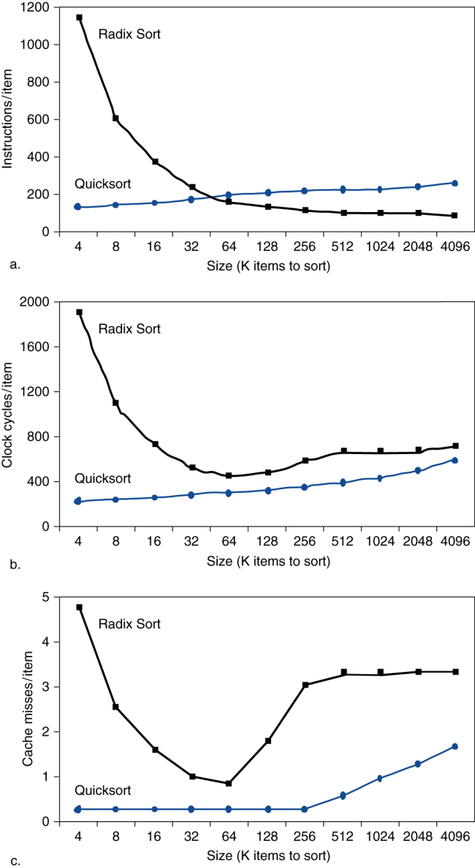
Interactions with Software
Misses can also depend on memory access patterns
Determined by
Algorithm behavior
Compiler optimization for memory access

Slide 84
Errors in Memory/Storage
Errors can happen during data transfer
Bit 1 → 0
Bit 0 → 1
Happen rarely, but still happen
So error detection is part of memory hierarchy system

Slide 85
Errors in Memory/Storage
Recall that in hard disk:
Each sector contains:
Sector ID
Data (512 bytes (0.5KB) - 4096 bytes (4KB))
Error correcting code (ECC)
Used to hide defects and recording errors
Synchronization fields and gaps

Slide 86
Error Detection - The Hamming SEC Code (Single-Error Correcting)
Hamming distance
Number of bits that are different between two bit-patterns
Example: Hamming distance between 01101010 and
11011011 = 4

Slide 87
Error Detection - The Hamming SEC Code
If the minimum (Hamming) distance between any two valid data is 2 – then we can detect single-bit errors
E.g. parity code
E.g. even parity: add a parity bit to data so that there’s always even number of 1s
If minimum distance = 3: provides single error correction, 2 bit error detection

Slide 88
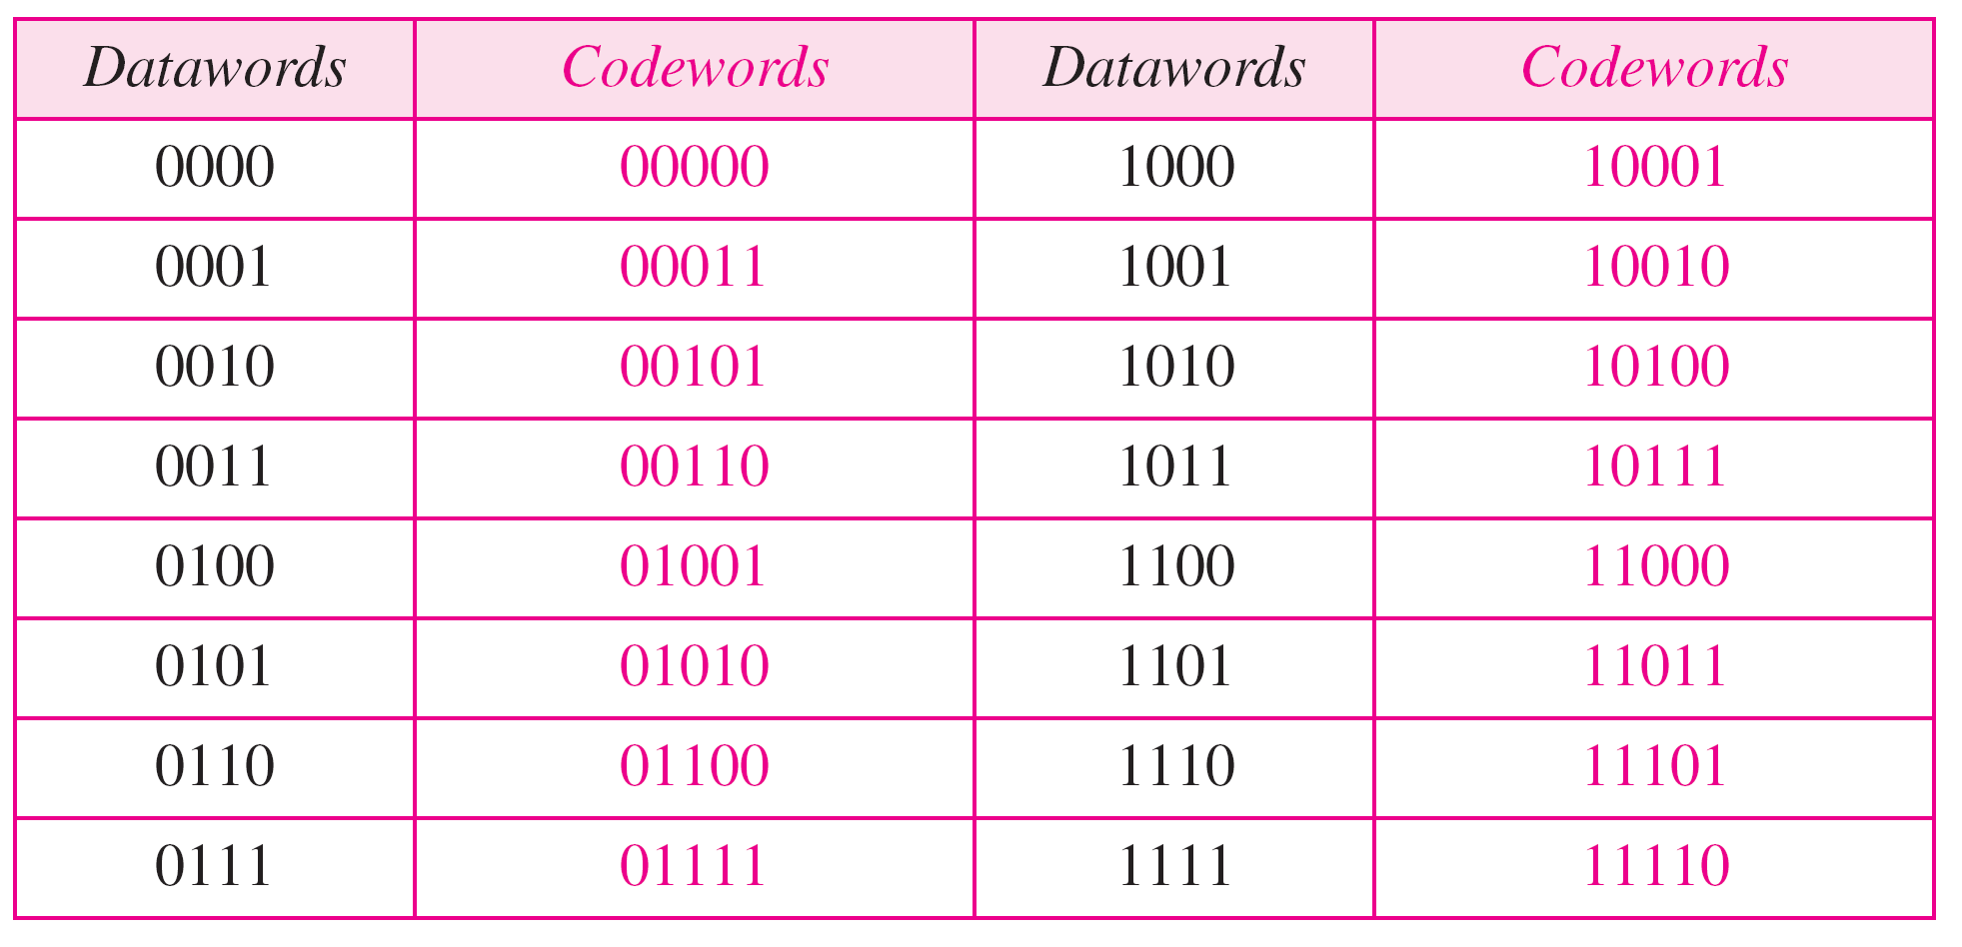
Even-Parity Code – Detect 1-Bit Error
We can know 1 bit was wrong (detect), but don’t know which bit (identify)
Ex. 00011→ 00111
00101→ 00111

Slide 89
Encoding SEC – Identify 1-Bit Error
Now we want to do better
Would like to not only know bits are wrong, but also know which bit(s) are wrong
SEC – Single Error Correction

Slide 90
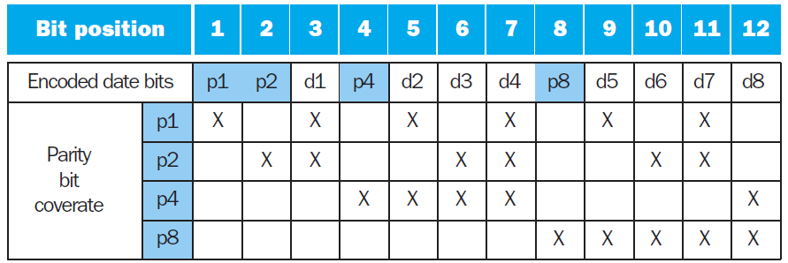
Encoding SEC – Identify 1-Bit Error
To calculate Hamming SEC code:
8 bits of real data; 4 more bits added for error detecting/locating -- 12 bits in total
Number bits from 1 on the left
All bit positions that are a power 2 are parity bits
Each parity bit checks certain data bits. E.g.
P1 is the parity bit for bits 1, 3, 5, 7, 9, 11
P2 is the parity bit for bits 2, 3, 6, 7, 10, 11, etc.

Slide 91
Encoding SEC Example
Even parity
Original data: __0_000_0000 (= 00000000)
Encoded data: 000000000000
Original data: __0_000_0001 (= 00000001)
Encoded data: 000100010001

Slide 92
Encoding SEC Example
Original data: __0_000_0001 (= 00000001)
Encoded data: 000100010001
Transfer / copy
Error
Received data: 000100010101
How do I know if there’s an error or not?

Slide 93
Decoding SEC
When receiving coded data, generate parity bits the same way
Value of parity bits indicates which bits are in error
Use numbering from encoding procedure
E.g. (0=even parity; 1=odd parity)
Parity bits = 0000 indicates no error
Non-zero parity bits mean there’s an error
E.g. Parity bits = 0101 (read from right to left) indicates bit 10_{dec} was flipped

Slide 94
Encoding SEC Example
Original data: 00000000; even parity
Encoded data: 000000000000
Suppose bit-ten flipped: 000000000100
Received data parity bits: 0101 (bit-ten wrong)

Slide 95
Encoding SEC Example
Original data: 00000001; even parity
Encoded data: 000100010001
Suppose bit-seven flipped: 000100110001
Received data parity bits: 1110 (bit 7 wrong)

Slide 96
SEC/DED Code
Add one more parity bit (p_{n}) for the whole word (data-bits + parity-bits)
Then we can correct (identify) 1-bit error, and detect 2-bit error
Decoding example: 4-bit data + 3-bit parity (H)
Let H = SEC parity bits (3 bits)
H even, p_{n} even (0), no error (H 3 bits, p_{n} 1 bit)
H odd, p_{n} odd (1), correctable single-bit error
H even, p_{n} odd (1), error in p_{n} bit
H odd, p_{n} even (0), double error occurred (don’t know which 2)
ECC (Error Correcting Codes) DRAM uses SEC/DED with 8 bits protecting each 64 bits

Slide 97
Virtual Memory
§5.7 Virtual Memory
Structure similar to memory-cache exists between disk and main memory
View main memory as a “cache” for disk (secondary) storage
Managed jointly by hardware and software (OS, operating system)
(memory-cache totally by hardware)

Slide 98
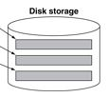
Virtual Memory
§5.7 Virtual Memory

Slide 99
Virtual Memory
§5.7 Virtual Memory
Multiple programs share main memory
Each gets a private virtual address space holding its frequently used code and data
Protected from other programs
CPU and OS translate virtual addresses to physical addresses
VM “block” is called a “page”
VM translation “miss” is called a “page fault”

Slide 100
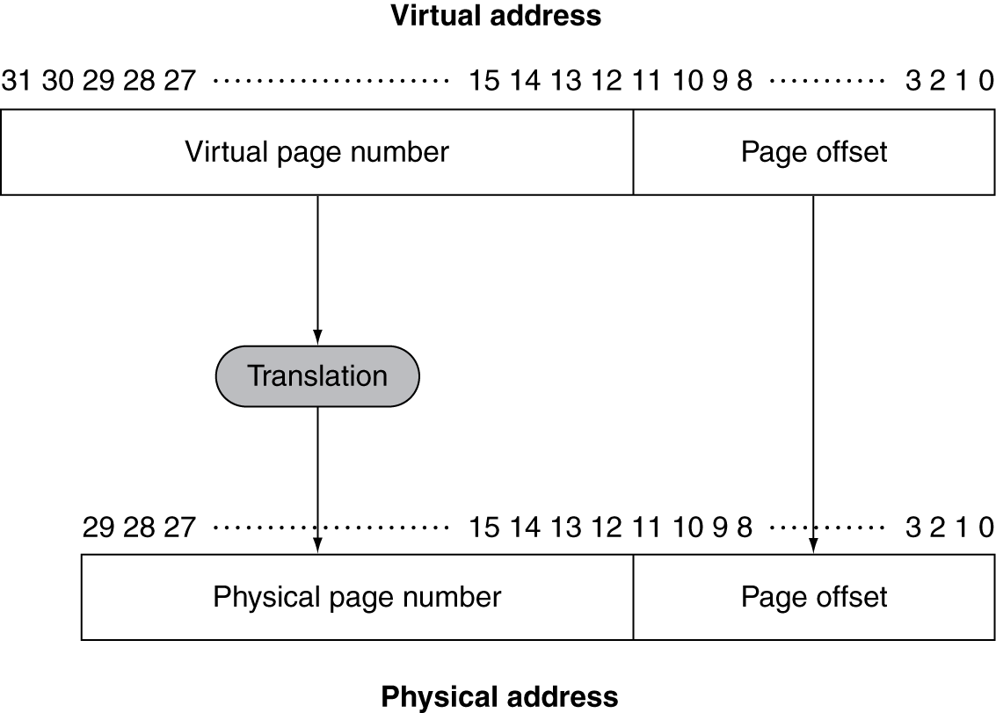
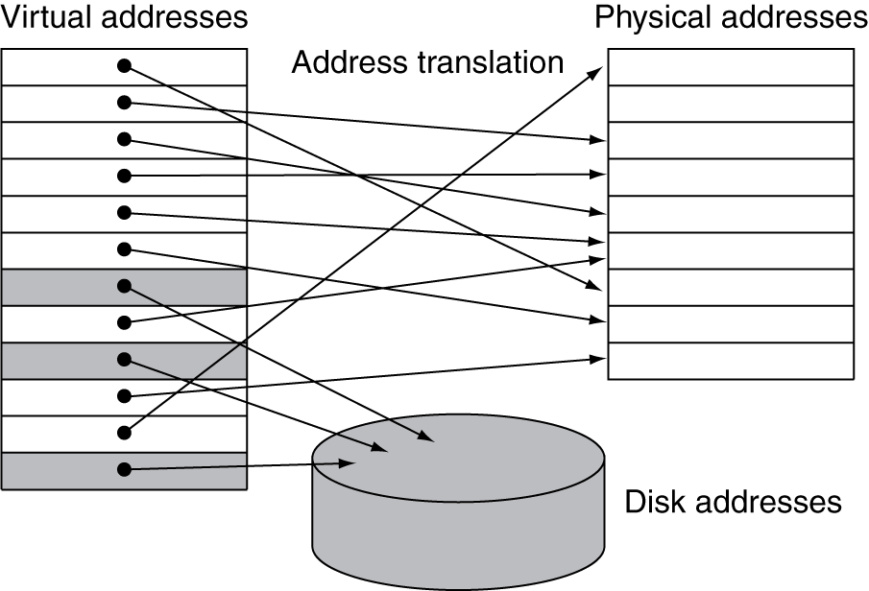
Address Translation
Page size is fixed (e.g., 4KB = 4096 Bytes)
Mem (8~16G)
Page Table
Disk (500G~1T)

Slide 101
Page Fault Penalty
On page fault, the page must be fetched from disk to main memory
Takes millions of clock cycles
Handled by OS code (program, not hardware)
We certainly want to minimize page fault rate
Placement policy – always fully associative
That is, a page on disk can go to anywhere in memory
Smart replacement algorithms

Slide 102
Page Table
Placement information is stored in Page Table
Array of page table entries, indexed by virtual page number (the whole disk)
CPU has a Page Table Register, which points to the beginning of Page Table in physical memory

Slide 103
Memory Hierarchy Levels
Cache
4
17
RAM (Memory)
Disk
101
102
103

Slide 104
Page Tables
(RAM)
Page Table
(part of OS,
also in RAM)
4
101
17
102
17
103
4

Slide 105
Page Tables
If page is present in memory
PTE (Page Table Entry) stores the physical page number
Plus other status bits (referenced, dirty, …)
If page is not present
PTE can refer to location in swap space on disk

Slide 106
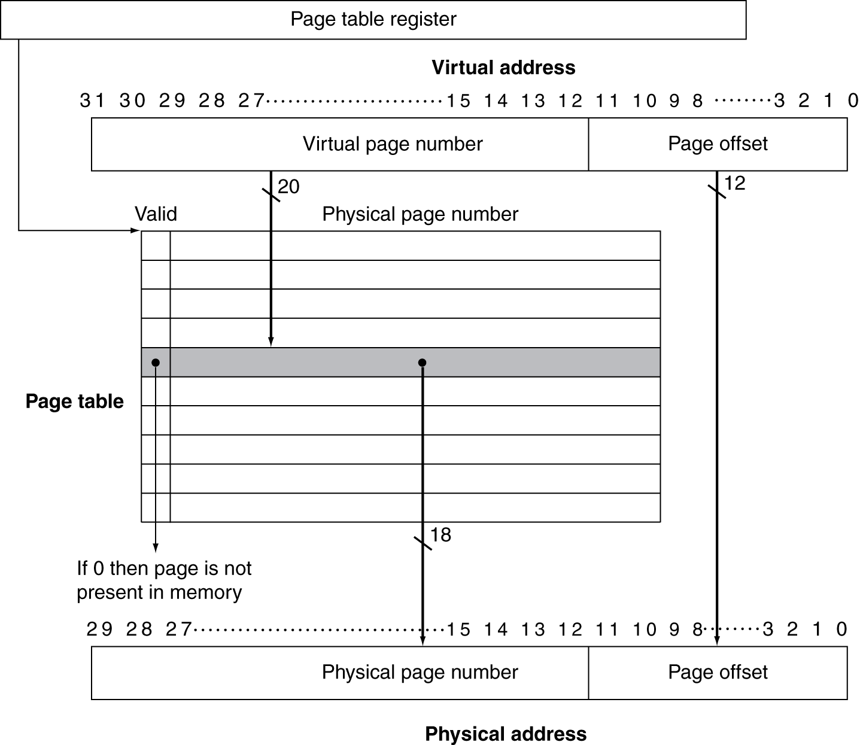
Translation Using a Page Table
2²⁰

Slide 107
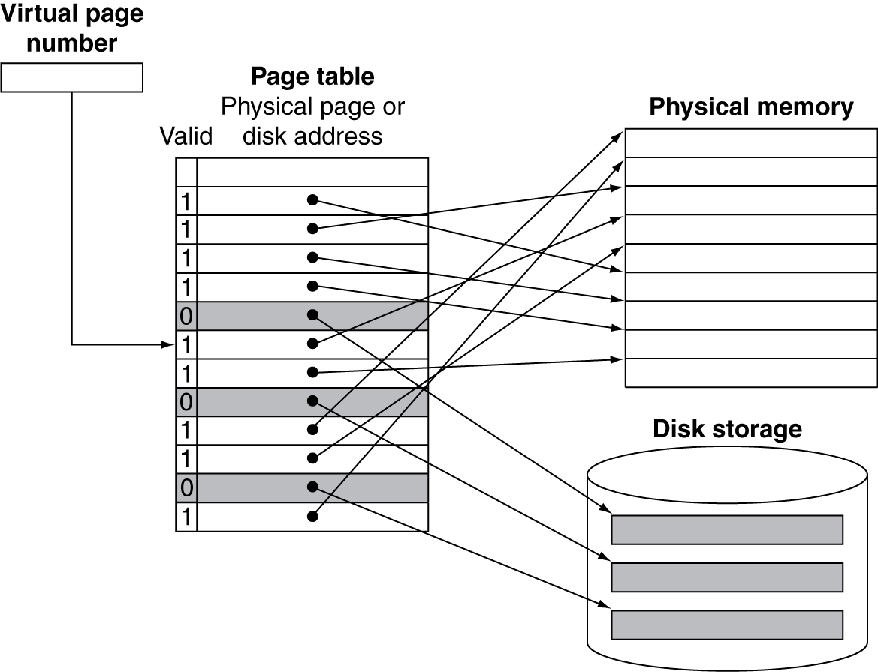
Mapping Pages to Storage
101
102
1
103
4

Slide 108
Replacement and Writes
To reduce page fault rate, prefer least-recently used (LRU) replacement
Reference bit (aka use bit) in PTE set to 1 on access to page (meaning it was just used)
Periodically cleared to 0 by OS
Meaning this page has not been used for a while
So all “0” pages are candidates for replacement

Slide 109
Replacement and Writes
Disk writes take millions of cycles
Write a block (a page) at a time, not individual locations
Write through (i.e. immediate write to disk) is impractical; not an option
Use write-back
That is, write to disk when page is being replaced
“Dirty bit” in PTE is set every time the page is written

Slide 110
Fast Translation Using a TLB
The Page Tables itself is in main memory
Address translation would require extra memory references
First reference to access the Page Table Entry (PTE)
Second reference is the actual memory access

Slide 111
Fast Translation Using a TLB
However, access to page tables has good locality, which can be taken advantage of
So use a fast cache of PTEs within the CPU
Called Translation Look-aside Buffer (TLB)
Typical TLB: 16–512 PTEs, 0.5–1 cycle for hit, 10–100 cycles for miss, 0.01%–1% miss rate
Misses could be handled by hardware or software

Slide 112
Mapping Pages to Storage

Slide 113
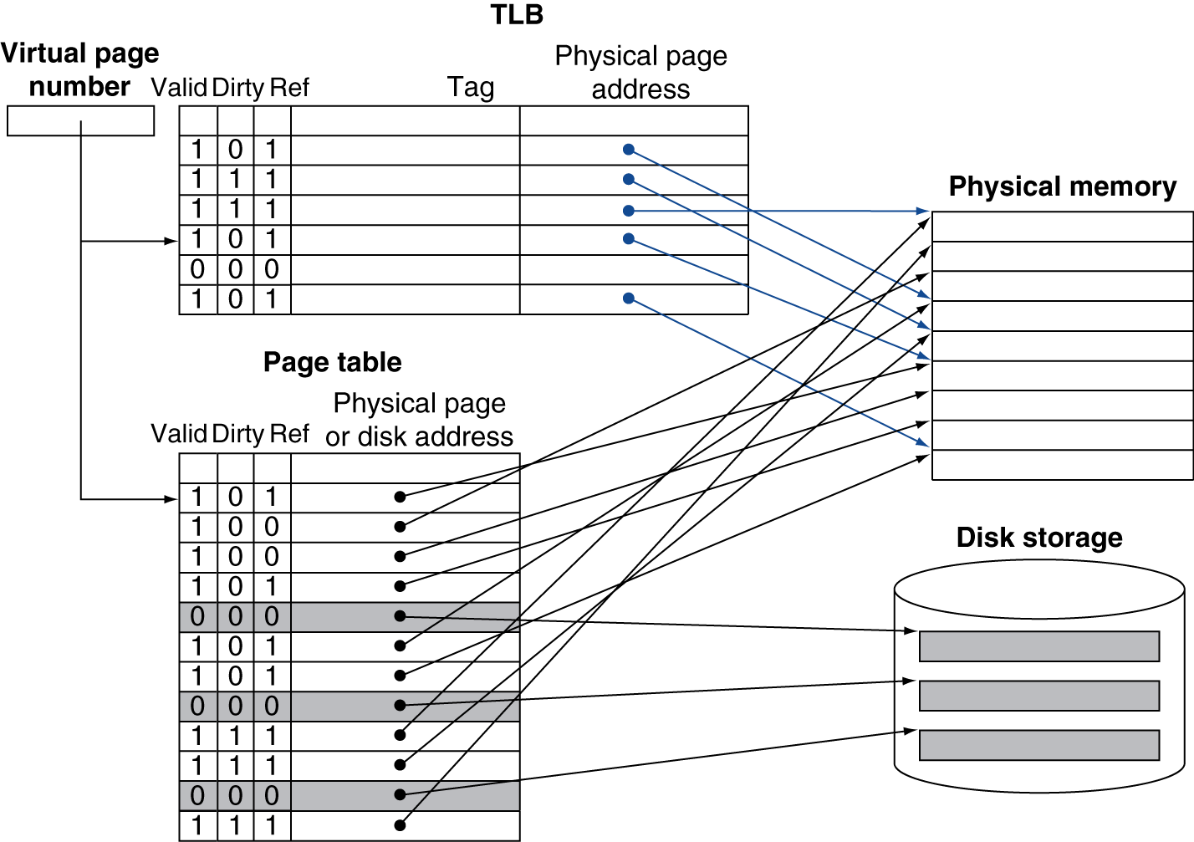
Fast Translation Using a TLB

Slide 114
TLB Misses – Page not in TLB
Case 1: If page is in memory
Load the PTE from memory to TLB and retry
Could be handled in hardware
Can get complex for more complicated page table structures
Or in software
Raise a special exception, with optimized handler

Slide 115
TLB Misses – Page not in TLB
Case 2: If page is not in memory - page fault
OS handles fetching the page and updating the page table
Then restart the faulting instruction

Slide 116
TLB Miss Handler
TLB miss indicates whether
Page present (i.e. in RAM), but PTE not in TLB
Or page not present (i.e. not in RAM)
Must recognize TLB miss before destination register overwritten
Raise exception ( ex. lw $2, 0($1) )
Handler copies PTE from memory to TLB
Then restarts instruction
If page not in memory, page fault will occur

Slide 117
Page Fault Handler
Fault -- Virtual address to PTE, find “not present” in memory (RAM)
Locate page on disk
Choose memory page to replace
If the mem page is dirty, write to disk first
Read page into memory and update page table
Make process runnable again
Restart from faulting instruction

Slide 118
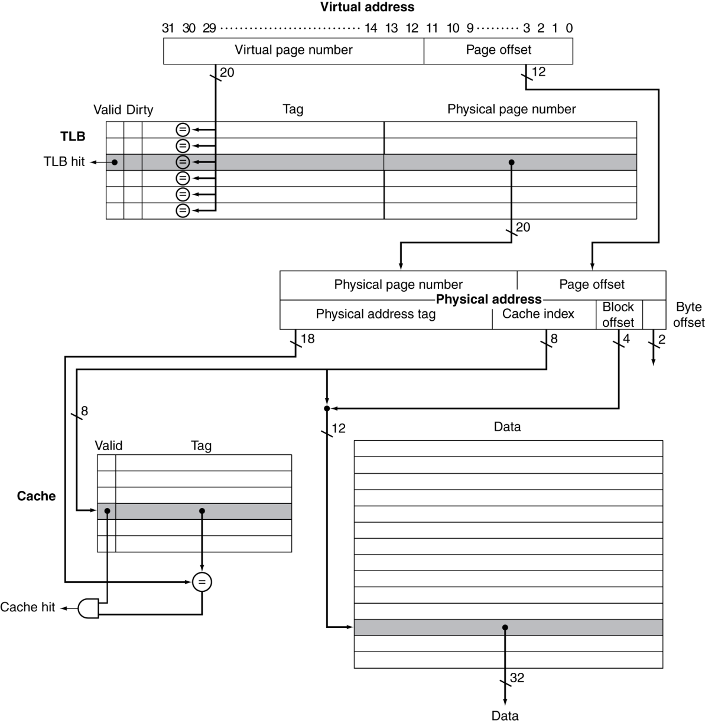
TLB and Cache Interaction
If cache tag uses physical address
Note that this example assumes virtual and physical pages have the same number of address bits (20 bits)
However, physical addresses should be smaller numbers
Cache
Cache

Slide 119
The Memory Hierarchy
The BIG Picture
Common principles apply at all levels of the memory hierarchy
Based on notion of caching
Issues at each level in the hierarchy
Block placement
Finding a block
Replacement on a miss
Write policy
§5.8 A Common Framework for Memory Hierarchies

Slide 120
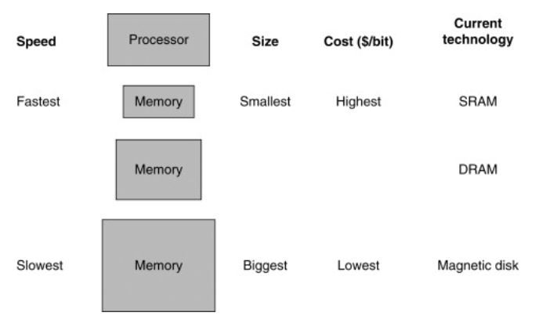
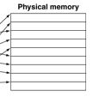
Mapping Pages to Storage
Cache
(~8MB)
(8~16GB)
Magnetic disk/
Solid-state drive (SSD)
(512G~1TB)

Slide 121
Mapping Pages to Storage

Slide 122
TLB and Cache Interaction
If cache tag uses physical address
Note that this example assumes virtual and physical pages have the same number of address bits (20 bits)
However, physical addresses should be smaller numbers
Cache
Cache

Slide 123
Block Placement
We want to load a page from disk storage to physical memory (RAM)
Issue: How to choose the location in physical memory?
For virtual memory, only full associativity is feasible

Slide 124
Recall: Cache Block Placement
Determined by associativity
Direct mapped (1-way associative)
One choice for placement, fast operation
n-way set associative
n choices within a set - limited flexibility
Fully associative
Any location - full flexibility
Higher associativity reduces miss rate
But increases complexity/cost/access time

Slide 125
Finding a Block
Associativity | Location method | Tag comparisons
Direct mapped | Index | 1
n-way set associative | Set index, then search entries within the set | n
Fully associative | Search all entries | #entries
 | Full lookup table | 0
Caches (hardware, between RAM and cache)
Reduce comparisons to reduce cost
Virtual memory (software, between disk and RAM)
Full table lookup makes full associativity feasible
Benefit: reduced miss rate

Slide 126
Replacement
Choice of entry to replace on a miss
Least recently used (LRU)
Complex and costly hardware for high associativity
Random
Close to LRU, easier to implement
Virtual memory
LRU approximation with hardware support
Use-bit set to 1 on access to page (meaning this page was just accessed)
Periodically cleared to 0
Choose “0”-pages for replacement

Slide 127
Write Policy
Write-through (cache only)
Update both upper and lower levels
Simplifies replacement; may require write buffer
Write-back (cache and virtual memory)
Update upper level only
Update lower level when block is replaced
Need to keep more states
Virtual memory (disk-RAM)
Only write-back is feasible, because disk-write latency is too long (millions of cycles)

Slide 128
Sources of Misses
Compulsory misses (aka cold start misses)
First access to a block (unavoidable)
Capacity misses
Due to finite cache size
A replaced block is later accessed again
Conflict misses (aka collision misses)
In a non-fully associative cache, multiple blocks have the same cache address
Due to competition for entries in a set
Would not occur in a fully associative cache of the same total size

Slide 129
Sources of Misses
Compulsory misses (aka cold start misses)
First access to a block (unavoidable)
Capacity misses
Due to finite cache size
A replaced block is later accessed again
Conflict misses (aka collision misses)
In a non-fully associative cache, multiple blocks have the same cache address
Due to competition for entries in a set
Would not occur in a fully associative cache of the same total size

Slide 130
Sources of Misses
Compulsory misses (aka cold start misses)
First access to a block (unavoidable)
Capacity misses
Due to finite cache size
A replaced block is later accessed again
Conflict misses (aka collision misses)
In a non-fully associative cache, multiple blocks have the same cache address
Due to competition for entries in a set
Would not occur in a fully associative cache of the same total size

Slide 131
Cache Design Trade-offs
Design change | Effect on miss rate | Negative performance effect
Increase cache size | Decrease capacity misses | May increase access time
Increase associativity | Decrease conflict misses | May increase access time
Increase block size | Decrease compulsory misses | Increases miss penalty. For very large block size, may increase miss rate due to loading in unused data (cache pollution)

Slide 132
Cache Control
Example cache characteristics
Direct-mapped, write-back, write allocate (aka fetch on write)
Block size: 4 words (16 bytes = 16 B)
Cache size: 16 KB (1K blocks = 2¹⁰ = 1024 blocks)
32-bit byte addresses
Valid bit and dirty bit per block
Blocking cache
CPU waits until access is complete
§5.9 Using a Finite State Machine to Control A Simple Cache
31
14
13
4
3
0
tag
index
offset
18 bits
10 bits
4 bits

Slide 133
Interface Signals
CPU
Cache
Memory
Read/Write
Read/Write
Valid
Valid
Address
32
Address
32
Write Data
32
Write Data
128
Read Data
32
Read Data
128
Ready
Ready
Multiple cycles per access
4-word block
= 128 bits

Slide 134
Finite State Machines for a Cache Controller
Use an FSM to sequence control steps
Set of states, transition on each clock edge
State values are binary encoded
Current state stored in a register
Next state = f_{n} (current state, current inputs)
Control output signals = f_{o} (current state)

Slide 135
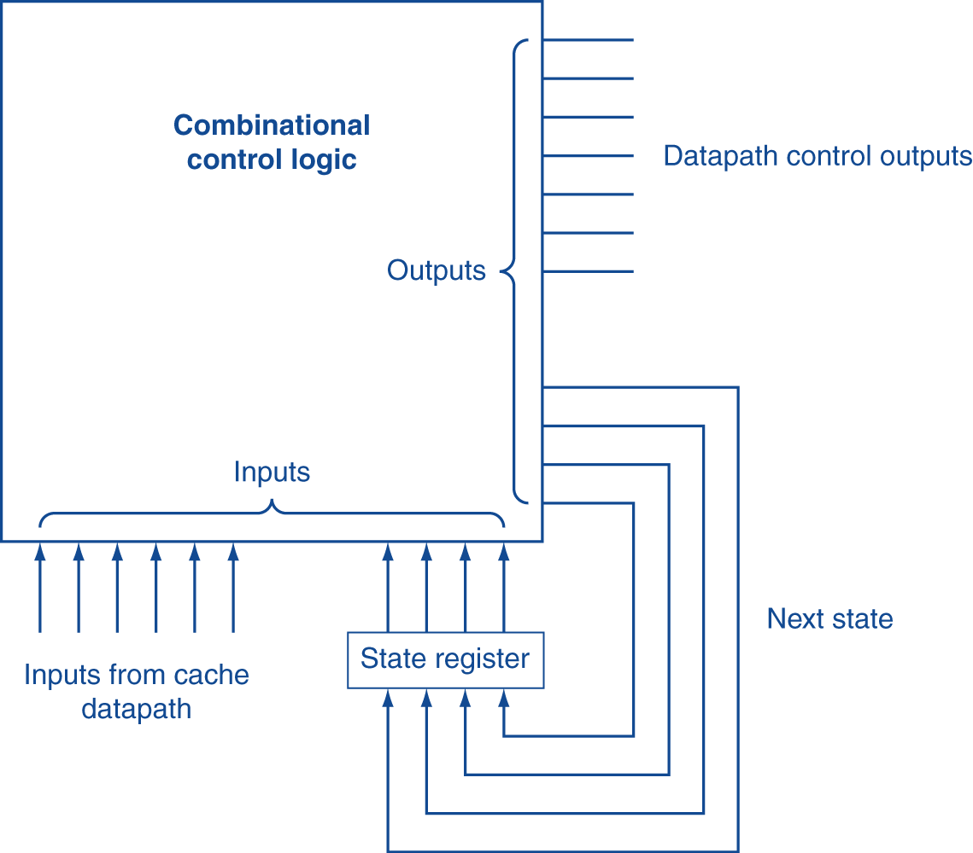
Cache Controller FSM

Slide 136
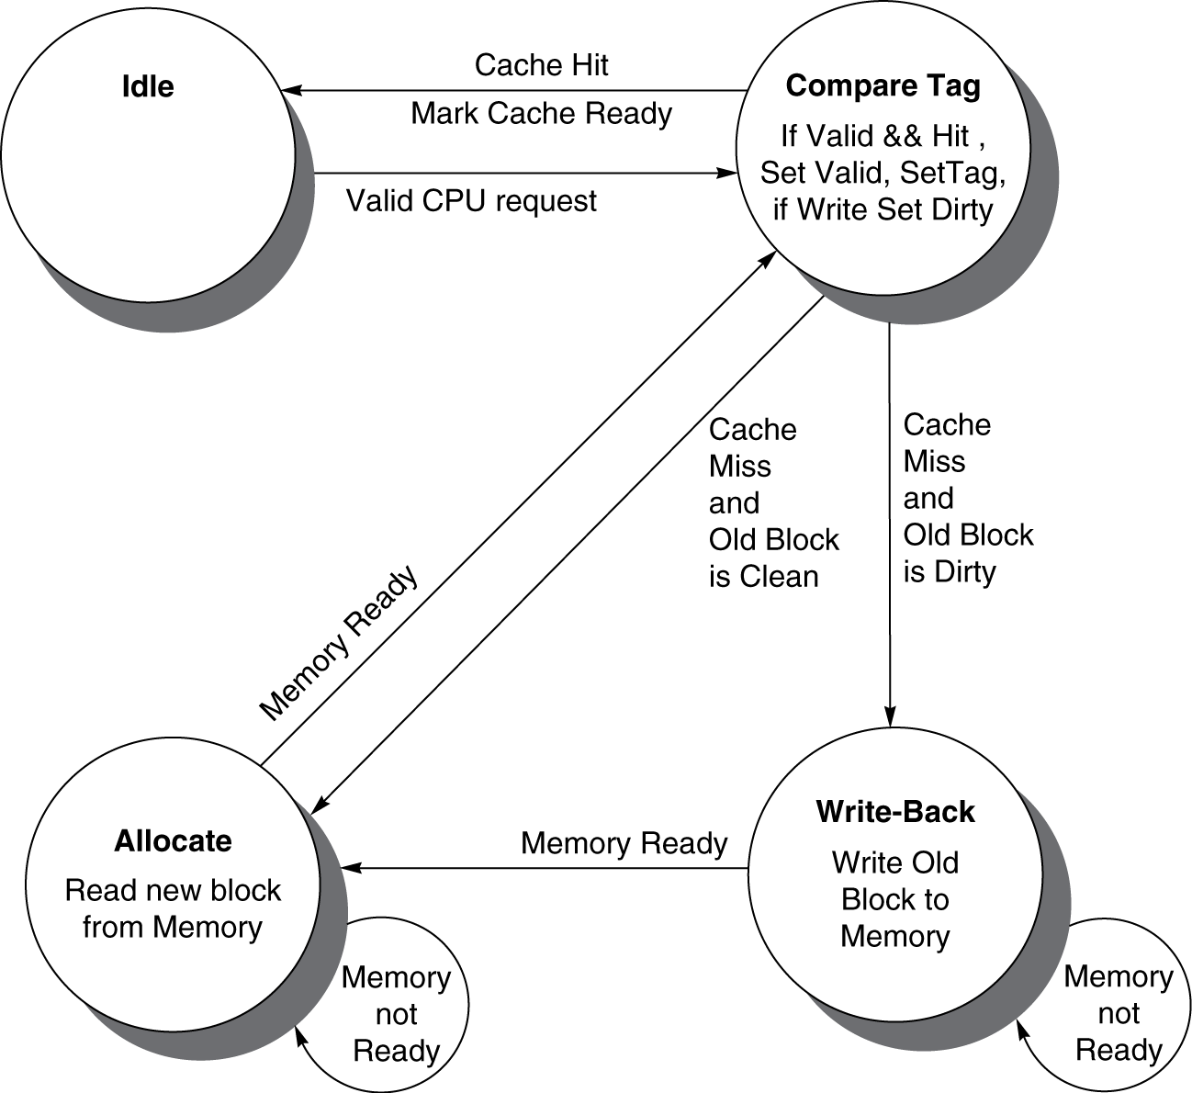
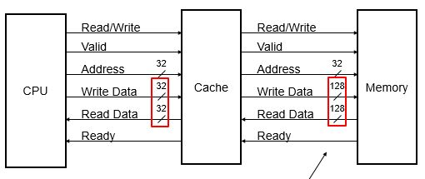
Cache Controller FSM
Could partition into separate states to reduce clock cycle time
No memory
access

Slide 137
Cache Coherence Problem
For multi-core, shared-memory processors
Suppose two CPU cores share a physical address space
Write-through caches (write to Mem immediately)
CPU
A
CPU
B
§5.10 Parallelism and Memory Hierarchies: Cache Coherence
Cache A
X: 0
Cache B
X: 0
X: 0
RAM (Mem)

Slide 138
Cache Coherence Problem
For multi-core, shared-memory processors
Suppose two CPU cores share a physical address space
Write-through caches (write to Mem immediately)
CPU
A
CPU
B
§5.10 Parallelism and Memory Hierarchies: Cache Coherence
A Write “1” to X
Cache A
X: 1
Cache B
X: 0
X: 0
RAM (Mem)

Slide 139
Cache Coherence Problem
For multi-core, shared-memory processors
Suppose two CPU cores share a physical address space
Write-through caches (write to Mem immediately)
CPU
A
CPU
B
§5.10 Parallelism and Memory Hierarchies: Cache Coherence
A Write “1” to X
Cache A
X: 1
Cache B
X: 0
Write-through
X: 1
RAM (Mem)

Slide 140
Cache Coherence Problem
For multi-core, shared-memory processors
Suppose two CPU cores share a physical address space
Write-through caches (write to Mem immediately)
CPU
A
CPU
B
§5.10 Parallelism and Memory Hierarchies: Cache Coherence
A Write “1” to X
Cache A
X: 1
Cache B
X: 0
B Reads X Wrong!
Write-through
X: 1
RAM (Mem)

Slide 141
Cache Coherence Problem
For multi-core, shared-memory processors
Suppose two CPU cores share a physical address space
Write-through caches (write to Mem immediately)
CPU
A
CPU
B
§5.10 Parallelism and Memory Hierarchies: Cache Coherence
A Write “1” to X
Cache A
X: 1
Cache B
X: 0
B Reads X Wrong!
Write-through
Coherence Problem!
X: 1
RAM (Mem)

Slide 142
Cache Coherence Problem
For multi-core, shared-memory processors
Suppose two CPU cores share a physical address space
Write-through caches (write to mem immediately)
Time step | Event | CPU A’s cache | CPU B’s cache | Memory
0 |  |  |  | X: 0
1 | CPU A reads addr. X | 0 |  | X: 0
2 | CPU B reads X | 0 | 0 | X: 0
3 | CPU A writes 1 to X | 1 | 0 | X: 1
§5.10 Parallelism and Memory Hierarchies: Cache Coherence

Slide 143
Define What “Coherence” Means
Informally: Reads should always return most recently written value
Formally:
P writes X; P reads X (no intervening writes) ⇒ read returns written value
P₁ writes X; P₂ reads X (sufficiently later, after X in P₂’s cache is updated) ⇒ read returns written value
c.f. CPU B reading X after step 3 in example
P₁ writes X, then P₂ writes X ⇒ all processors see writes in the same order
End up with the same final value for mem addr X

Slide 144
Invalidating Snooping Protocols
Cache gets exclusive access to a block when it is to be written
Broadcasts an invalidate message on the bus
Subsequent read in another cache will be a miss
Owning cache supplies updated value
CPU activity | Bus activity | CPU A’s cache | CPU B’s cache | Memory
 |  |  |  | 0
CPU A reads X | Cache miss for X | 0 |  | 0
CPU B reads X | Cache miss for X | 0 | 0 | 0
CPU A writes 1 to X | Invalidate for X | 1 | Invalid | 1
CPU B reads X | Cache miss for X | 1 | 1 | 1

Slide 145
Memory Consistency
Make sure writes seen by other processors
“Seen” means a read returns the written value
Can’t be instantaneously – should read “sufficiently” later after write
Assumptions
A write completes only when all processors have seen it – wait sufficiently long after actual write
A processor does not reorder writes with other accesses
Consequence
P writes X then writes Y ⇒ all processors that see new Y also see new X
Processors can reorder reads, but not writes

Slide 146
Concluding Remarks
Fast memories are small, large memories are slow
We really want fast, large memories ☹
Caching gives this illusion ☺
Principle of locality
Programs use a small part of their memory space frequently
Memory hierarchy
L1 cache ↔ L2 cache ↔ … ↔ DRAM memory ↔ disk
Memory system design is critical for multiprocessors
§5.16 Concluding Remarks

